Slide 1
Week 6 evolutionary trees

Slide 2
Phylogenetic Trees
Also called ‘evolutionary trees’
Represent a branching history of common ancestry of a group of samples
Rarely do we know the true history of a set of samples
Unless data were simulated in the laboratory, or there are extensive historical records
Usually an evolutionary tree is an estimate of the history

Slide 3
Phylogenetic Trees
Before the availability of protein and DNA sequence data, trees were estimated using morphological traits
For example
Adult skull shape in mammals
Embryological features
Features of the system for sexual reproduction
With protein and DNA sequences, things are easier
We know the traits are heritable
Differences are more easily measured
Evolution is more easily modeled with sequences
Trees estimated using the sequences of genes or genomes are often called ‘gene trees’
A gene tree may be an estimate of a phylogenetic tree

Slide 4
Parts & Properties of Tree Diagrams
External Nodes = Tips
B
A
C
A
B
Labels = Sample names = OTU (operational taxonomic units
External Branches
Internal Branches
C
D
Internal Nodes = Branch Points

Slide 5
B
A
C
A
B
Time
Root Node
C
D
Trees may be oriented by time (Rooted Trees), or not (Unrooted Trees)
Rooted Trees have a root node

Slide 6
Polytomy
Estimated Trees may have multiple branches joining at a node
Properly Estimated Trees may not have closed loops

Slide 7
Where is the information in the tree?
Topology, branching pattern, specifies the pattern of ancestry
Branch length.
May or may not be included in a tree diagram. If it is included it may indicate either estimated time, or estimated amounts of change in the OTUs

Slide 8
A
B
C
D
E
A
B
C
D
E
E
C
B
A
D
A
C
C
D
B
A
E
D
B
E
All of these trees have the same topology

Slide 9
On an unrooted tree you do not know which branch passed thru the oldest time point.
A
C
B
E
When you root a tree you determine which branch includes the root node and the oldest time point.
A
C
D
B
E
Rooting a tree adds an internal node and gives a time direction to all of the branches
A
B
C
E
D
D
Time

Slide 10
How to root a tree?
Include an outgroup - an OTU for which you have prior knowledge that it is more distantly related to all the other OTUs than they are to each other
A
C
A
B
C
E
D
B
E
Time
D

Slide 11
Newick Format
A
Newick Format – represent a tree by text, using labels and parentheses
Every internal node is represented by a pair of parentheses
(A,B)
((A,B),C)
(((A,B),C),D)
((((A,B),C),D), E)
If tree is unrooted, then there are multiple alternative placements for parentheses
((((A,B),C),D), E)=(((A,B),C),(D, E))
C
B
E
D
A
B
C
D
E
C
D
A
B
E

Slide 12
Newick Format
A Newick representation of a tree allows the tree to be represented as a string (good for computer manipulations)
But, Newick representations are not unique, for two reasons:
For unrooted trees, there are multiple places where the root could occur and so multiple alternative Newick configurations
2. For every pair of parentheses, the nodes contained within can be rearranged in any order
Example, all of these are the same tree
((A,B),C) (C,(A,B)) ((B,A),C) (C, (B, A))

Slide 13
How many internal nodes are there?
On an unrooted tree of n OTUs there will be n-2 internal nodes
On a rooted tree there is one more internal node, n-1
A
C
A
B
C
E
D
B
E
Time
D

Slide 14
Rooted and Unrooted trees
Archaea 1
Eukaryote 1
Archaea 3
Unrooted tree
Archaea 2
Eukaryote 2
Eukaryote 4
The root defines
common ancestry
Eukaryote 3
bacterial outgroup
Archaea 1
Tree rooted
by outgroup
Archaea 2
Monophyletic group
Archaea 3
Eukaryote 1
Eukaryote 2
Monophyletic
group
root
Eukaryote 3
Eukaryote 4
Notes:
Geoff

Slide 15
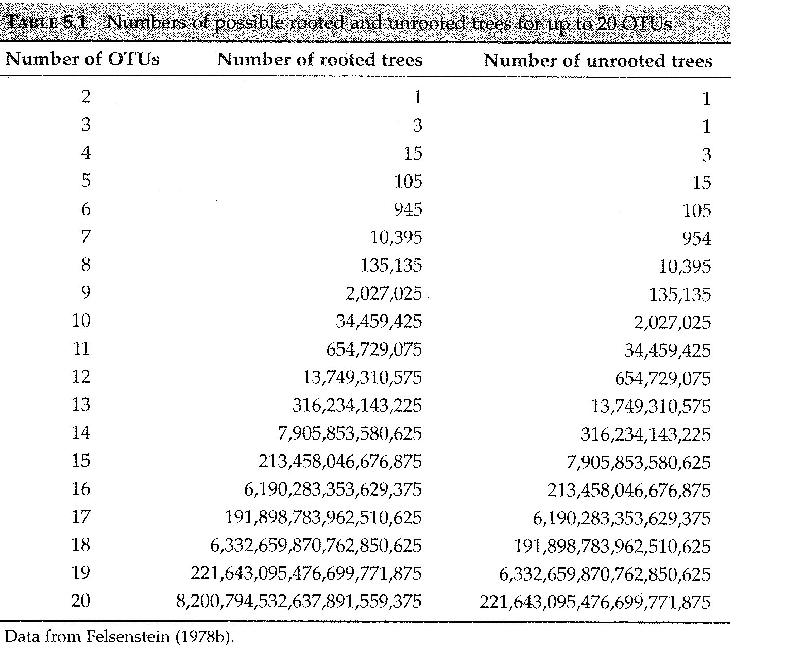
How many possible trees are there?

Slide 16
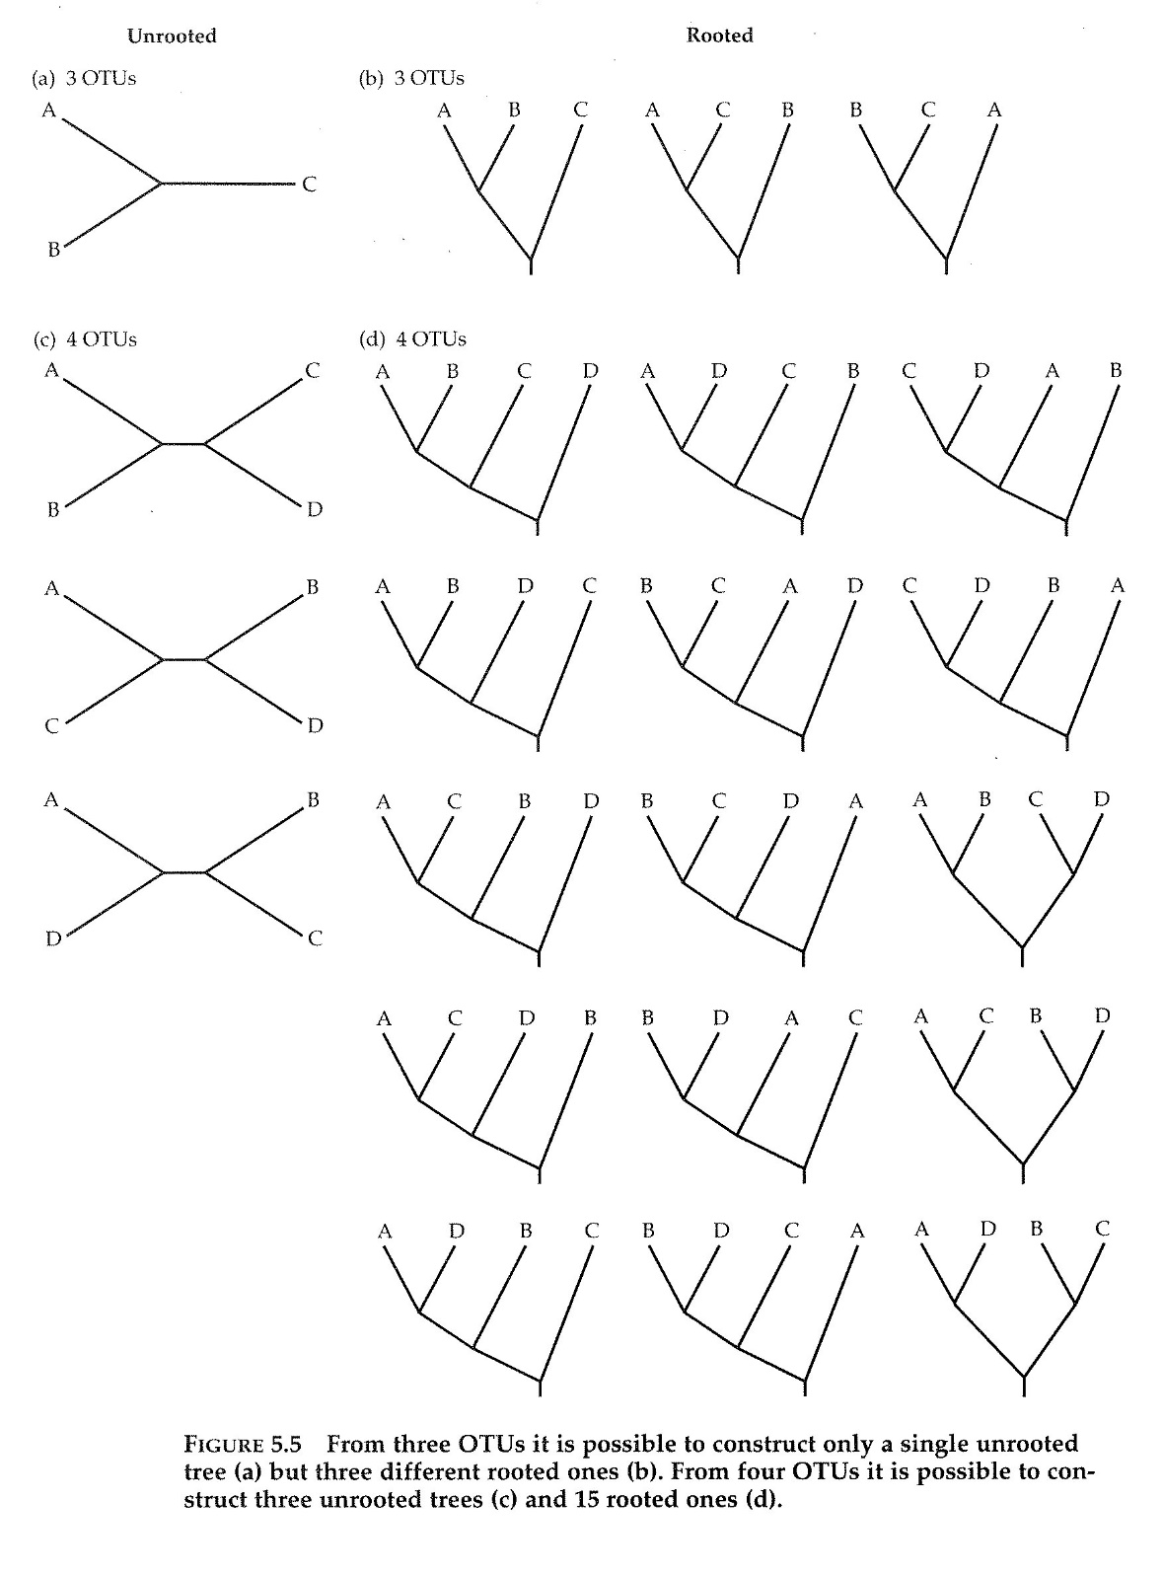
How many possible trees are there?

Slide 17
The special case of ultrametric trees
An ultrametric tree is a rooted tree for which all of the paths from the root to each of the tips has the same length.
The true historical trees for a set of data (i.e. sampled data – species sequences etc) sampled at the same time, will literally be an ultrametric tree
Similar to a time tree – i.e. a tree where the branch lengths are in units of time.
A time tree for data all collected at the same time will be an ultrametric tree.
It is possible to have a time tree for a mixture of living and fossil data, in which case not all paths from root to tip need to have the same length
A
B
C
E
D

Slide 18
Monophyletic groups
Every internal node or branch on a rooted tree defines a group of descendant nodes and branches
Clade : a group of OTUs, all of which descend from a particular internal node (or alternatively from a particular branch) for a group
A taxonomic group is Monophyletic if all of the items in that group form a complete clade on a phylogenetic tree

Slide 19
Monophyletic groups - 2
A taxon is a category of organisms.
A taxon may be a species, or it may include multiple species
For example, Homo sapiens or Class Mammalia
If species A, B, and C all belong to the same taxonomic group, and there are no other species in the group, and if A, B and C constitute a clade on a phylogenetic tree, then that group is monophyletic
A group consisting of A, B, C and D (but not E) is not monophyletic
A
B
C
E
D

Slide 20
Monophyletic groups - 3
A group is paraphyletic if it includes some, but not all of the descendants of a single common ancestor.
If A, B and E fully constitute a taxon, then it is paraphyletic because the clade that includes these also includes C.
A
B
C
E
D

Slide 21
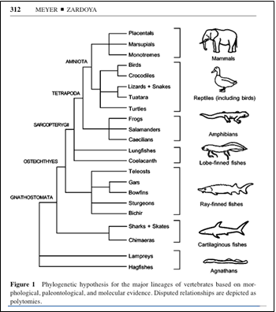
Monophyletic groups - 4
Should taxa (named groups of organisms used in classification) be monophyletic?
Monophyletic groups are a kind of ‘natural group’
Most systematists feel that taxa should be monophyletic
But many widely used taxa are not monophyletic
For example, reptiles.
Class reptilia includes crocodiles, who share common ancestry more recently with birds, than with other reptiles

Slide 22
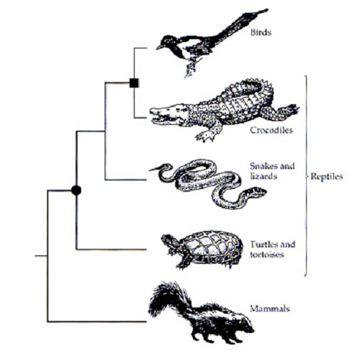
Class reptilia includes crocodiles, who share common ancestry
more recently with birds, than with other reptiles
Reptiles: paraphyletic group

Slide 23
Two general categories of theories of tree estimation
Distance methods
Fast
Character based methods
also called Optimization methods
Maximum parsimony
Maximum likelihood & Bayesian
Slow

Slide 24
Distance methods
two distinct steps
Generate a distance matrix from the data.
Construct a tree, using an algorithm ( a step by step procedure that is repeated for every internal node in the tree)
Very useful for data that is easily put into a distance matrix
very quick
there is just one tree for every data set

Slide 25
Distances
Consider every possible pair of OTUs (e.g. different DNA sequences in the sample), and for each pair calculate a distance
What is a good measure of distance?
Let d (a,b) be the distance between two sequences a and b.
For a distance measure, say d(), to be used to build phylogenies it must satisfy some basic requirements...
The distance measure should be a metric
The distance measure should be additive

Slide 26
Metric Distances
Then a distance measure, d(,), is a metric if it satisfies conditions:
d (a,b) ≥ 0, for all a, b (non-negativity)
d (a,b) = d (b,a) (symmetry)
d (a,c) < d (a,b) + d (b,c) (triangle inequality)
The distance between any pair of sequences must be no greater than the sum of the distances between those sequences and a third sequence.
d (a,b) = 0 if and only if a=b (distinctness)
For most mathematically calculated distances from DNA sequences, non-negativity, symmetry and distinctness usually apply.
For distances obtained experimentally (e.g. DNA hybridization), symmetry and triangle inequality may not hold.

Slide 27
Comparing distance matrices and their trees
Distance Matrix – a matrix will all pairwise distances calculated from the data
Distance Tree – a phylogenetic tree generated from a distance matrix
patristic distance - the length of the branches on a tree between two items.
if actual distances in the distance matrix are similar to the patristic distances, then the tree fits the data well, and the data is represented well by a tree.
 | A | B | C | D
A |  | d(A,B) | d(A,C) | d(A,D)
B |  |  | d(B,C) | d(B,D)
C |  |  |  | d(C,D)
D
A
B
x
z
y
C
D
The patristic distance from A to D is (x+y+z)
Is this close to d(A,D)?

Slide 28
Building a distance matrix
Align the DNA sequences
Decide what measure of distance to use
Calculate a distance for each pair of sequences
For n sequences there will be
n(n-1)/2 distinct pairs

Slide 29
Building a distance matrix using the number of observed differences
Example - Consider four DNA sequences
A GTACAAATGACGACATG
B GTACGAATGACGACATG
C GTACGAATGACGATATA
D GCACGAATGACGATACG
^ ^ ^ ^^
Count the number of differences for each pair.
Complete the matrix
 | A | B | C | D
A |  | 1 | 3 | 4
B |  |  | 2 | 3
C |  |  |  | 3
D

Slide 30
Building a distance matrix using the Jukes Cantor Distance
First calculate the proportion (p) of differences for each pair of sequences
Then apply the Jukes Cantor formula to get K’, the estimated number of changes per site, for each pair of sequences
K’ = - ¾ ln(1-4 p/3)
In the example from the previous slide the sequences were 17 bp long
 | A | B | C | D
A |  | 1/17 | 3/17 | 4/17
B |  |  | 2/17 | 3/17
C |  |  |  | 3/17
D
 | A | B | C | D
A |  | 0.061 | 0.201 | 0.282
B |  |  | 0.128 | 0.201
C |  |  |  | 0.201
D

Slide 31
Example of a distance algorithm: UPGMA (Unweighted Pair-Group Method with Arithmetic Mean)
‘Algorithm’ - a procedure, a set of well-defined instructions for doing a particular calculation
UPGMA Algorithm
Select the smallest distance d_{ij} from the distance matrix
Identify which OTUs are in the row and column that intersect at that smallest value
create a cluster on the tree with those two OTUs joined by branches of length d_{ij}/2
Create a new distance matrix by dropping the two rows and the two columns associated with i and j, and replacing them with a new row and a new column for new OTU (i,j)
Calculate all the the distances between other OTUs and (i,j), d_{(ij)k} = (d_{ik} +d_{jk})/2
return to step 1 and repeat
keep repeating until there is just one cluster

Slide 32
UPGMA – example slide 1
Select smallest distance, d_{A,B} = 1
Identify which OTUs: A and B
create a cluster on the tree with those two OTUs joined by branches of length d_{ij}/2 : d_{A,B}/2=0.5
Create a new distance matrix by deleting the two rows and the two columns associated with i and j, and replacing them with a new row and a new column for a new OTU, (i,j)
Calculate all the the distances between other OTUs and (i,j), d_{(ij)k} = (d_{ik} +d_{jk})/2
 | A | B | C | D
A |  | 1 | 3 | 4
B |  |  | 2 | 3
C |  |  |  | 3
D
A
B
[0.5]
 | A,B | C | D
A,B |  | 2.5 | 3.5
C |  |  | 3
D

Slide 33
UPGMA – example slide 2
Select smallest distance, d_{(A,B)C} = 2.5
Identify which OTUs: (A,B) and C
create a cluster on the tree with those two OTUs joined by branches of length d_{ij}/2 : d_{(A,B)C}/2=1.25
Create a new distance matrix by deleting the two rows and the two columns associated with i and j, and replacing them with a new row and a new column for a new OTU, (i,j)
Calculate all the the distances between other OTUs and (i,j), d_{(ij)k} = (d_{ik} +d_{jk})/2
 | A,B | C | D
A,B |  | 2.5 | 3.5
C |  |  | 3
D
C
[1.25]
A
B
[0.5]
 | (A,B),C | D
(A,B),C |  | 3.25
D

Slide 34
UPGMA – example slide 3
Select smallest distance, d_{((A,B)C),D} = 3.25
Identify which OTUs: ((A,B),C) and D
create a cluster on the tree with those two OTUs joined by branches of length d_{ij}/2 : d_{((A,B)C)D}/2=1.625
Create a new distance matrix by deleting the two rows and the two columns associated with i and j, and replacing them with a new row and a new column for a new OTU, (i,j)
 | (A,B),C | D
(A,B),C |  | 3.25
D
C
[1.25]
A
B
[0.5]
[1.625]
D
 | ((A,B),C),D
((A,B),C),D

Slide 35
UPGMA – example slide 4
Compare original distances and the patristic distances
If they are similar then UPGMA provides a good fit to the data
Original Distances
 | A | B | C | D
A |  | 1 | 3 | 4
B |  |  | 2 | 3
C |  |  |  | 3
D
C
Patristic Distances
 | A | B | C | D
A |  | 1 | 2.5 | 3.25
B |  |  | 2.5 | 3.25
C |  |  |  | 3.25
D
[1.25]
A
B
[0.5]
[1.625]
D

Slide 36
UPGMA features
Advantages of UPGMA
Fast, Simple
Yields equal total branch lengths on both sides of every node.
generates a rooted tree
Disadvantages
Assumes additivity – that the value in the distance matrix is approximately the sum of changes along the branches of the tree between two OTUs
Very strong assumption that rate of evolution is constant.
This is often wrong, and leads to UPGMA trees being way off.

Slide 37
Neighbor-joining
Neighbor-joining, like UPGMA, is a distance method
Begin with a Star Phylogeny
[no topology]
NJ Algorithm – repeat for each node until the tree is done.
Consider all possible pairs of OTUs to join at a node.
Calculate the total length of the tree, using the values in the distance matrix, and averages of those values.
select the node that provides the shortest total length of the tree.
Repeat – adding a new node for each repetition until the tree is complete
A
B
C
D
E
A
B
D
C
E

Slide 38
Neighbor-joining-2
Advantages
Does not assume constant rate of evolution
Works very well if distances are additive
Disadvantages
Does assume additivity – means that distances must actually reflect the amount of evolution that has occurred
Does not provide a root.
Can yield negative branch lengths.
A
B
C
D
E
A
B
D
C
E

Slide 39
Character based (optimization) methods for estimating phylogenetic trees
Consider the data and a particular tree together and ask how well the data fit the tree.
Search among all possible trees for the one that fits best.
Two main categories of methods
Maximum parsimony
the best tree is the one with the fewest character changes (e.g. mutations) on it.
Maximum likelihood
the best tree is the one that is most likely under a model of the probablity distribution of mutations.
Very useful for data in discrete character states.
Slow
The result is a tree with character state changes on the branches – very useful for studying character state changes.

Slide 40
Maximum Parsimony
based on the parsimony principle
One should not make more assumptions than are needed
in general one should pursue the simplest hypothesis
Ockham's Razor is the principle proposed by William of Ockham in the fourteenth century.
“entities should not be multiplied beyond necessity”
One should find the simplest explanation possible.

Slide 41
Maximum Parsimony -2
Traits = characters, features of the gene (or organism, species population, taxon-whatever) that are variable in your data set.
Character state - the particular value that a character has -if DNA sequence, a character is a base position, and the state is the base value
Some character value comparisons reveal information about common ancestry.
Informative characters
If more than one character state is shared by more than one OTU, then we can say that character is informative.
An informative site is one that provides evidence for common ancestry and thus for grouping of multiple OTUs.
If a character distinguishes just one OTUs, then it can always be placed on any tree, and is of no use in deciding what is the best tree.

Slide 42
The Maximum Parsimony Algorithm
For each of the possible trees (each possible topology)
Place every variable character (each polymorphic site) on a tree with the fewest possible changes.
For each polymorphic site, count the minimal possible number of changes required for that tree character on that tree
A character with n states must have at least n-1 changes. Thus the minimum possible number of mutations for a character with n states is n-1.
Nonvariable characters are not included
Calculate the Length L - the sum over all variable characters, of the minimum number of changes at each character
Also calculate the minimum possible length, M
Repeat for All Possible Trees
The tree (or trees – there may be many) that have the smallest value of L is the Maximum Parsimony tree

Slide 43
Homoplasy
the presence of more mutations than the minimum possible for a character. For unordered characters with n character states, the minimum possible number of changes is n-1.
if a set of DNAs are truly homologous and have a branching history, and if the infinite sites assumptions hold, then the shortest tree will have every informative site represented by just one mutation.
Consistency Index for a tree - C - the minimum number of possible changes M, divided by the actual Length of the tree,L
C = M/L

Slide 44
Example of Maximum Parsimony
Consider four aligned DNA sequences
Consider only the variable positions
1 GTCACACATAC
2 GTCGCACATGT
3 GCCGCATATAA
4 GCCGCATACGC
1 2 3 456
1 TACTAC
2 TGCTGT
3 CGTTAA
4 CGTCGC
123456

Slide 45
Consider 1 unrooted tree
Consider each character, one at a time
For character 1, what is the minimum possible number of changes (not considering the tree)
1 - A change from T to C, or the reverse
For character 1, what is the minimum number of changes, if the character states are added to the tree ?
1 – a change on the internal branch of the tree
1 TACTAC
2 TGCTGT
3 CGTTAA
4 CGTCGC
123456
2
4
C
T
T
M = 1 + …
L = 1 + …
C
1
T
3
C

Slide 46
Consider 1 unrooted tree - 2
For character 2, what is the minimum possible number of changes (not considering the tree)
1 - A change from A to G, or the reverse
For character 2, what is the minimum number of changes, if the character states are added to the tree ?
1 – a change on the branch to OUT #1
1 TACTAC
2 TGCTGT
3 CGTTAA
4 CGTCGC
123456
2
4
G
G
A
M = 1 + 1 +…
L = 1 + 1 +…
G
1
A
3
G

Slide 47
Consider 1 unrooted tree - 3
For character 3, what is the minimum possible number of changes (not considering the tree)
1 - A change from C to T, or the reverse
For character 3, what is the minimum number of changes, if the character states are added to the tree ?
1 – a change on the internal branch of the tree
1 TACTAC
2 TGCTGT
3 CGTTAA
4 CGTCGC
123456
2
4
T
C
C
M = 1 + 1 + 1 +…
L = 1 + 1 + 1 +…
T
1
C
3
T

Slide 48
Consider 1 unrooted tree - 4
For character 4, what is the minimum possible number of changes (not considering the tree)
1 - A change from C to T, or the reverse
For character 4, what is the minimum number of changes, if the character states are added to the tree ?
1 – a change on the branch leading to OUT # 4
1 TACTAC
2 TGCTGT
3 CGTTAA
4 CGTCGC
123456
2
4
C
T
C
T
M = 1 + 1 + 1 + 1 +…
L = 1 + 1 + 1 + 1 + …
1
T
3
T

Slide 49
Consider 1 unrooted tree - 5
For character 5, what is the minimum possible number of changes (not considering the tree)
1 - change from A to G, or the reverse
For character 5, what is the minimum number of changes, if the character states are added to the tree ?
2 – a change on two external branchs, there are multiple possibilities
1 TACTAC
2 TGCTGT
3 CGTTAA
4 CGTCGC
123456
2
4
G
G
G
G
A
A
M = 1 + 1 + 1 + 1 + 1…
L = 1 + 1 + 1 + 1 + 2…
1
A
3
A

Slide 50
Consider 1 unrooted tree - 6
For character 6, what is the minimum possible number of changes (not considering the tree)
2 – because there are three character states
For character 6, what is the minimum number of changes, if the character states are added to the tree ?
2 – a change on two external branchs, and there are other possibilities
1 TACTAC
2 TGCTGT
3 CGTTAA
4 CGTCGC
123456
2
4
C
T
T
C
C
M = 1 + 1 + 1 + 1 + 1+2 = 7
L = 1 + 1 + 1 + 1 + 2 + 2 =8
1
A
C
3
A

Slide 51
Consider a second unrooted tree
Consider each character, one at a time
For character 1, what is the minimum possible number of changes (not considering the tree)
1 - A change from T to C, or the reverse
For character 1, what is the minimum number of changes, if the character states are added to the tree ?
2 – a change on two external branches, there are multiple possibilities
1 TACTAC
2 TGCTGT
3 CGTTAA
4 CGTCGC
123456
3
4
C
C
T
C
M = 1 + …
L = 2 + …
C
1
T
2
T
T

Slide 52
Consider a second unrooted tree-2
Consider each character, one at a time
1 TACTAC
2 TGCTGT
3 CGTTAA
4 CGTCGC
123456
CGTCGC
3
4
CGTTAA
M = 1 + 1 + 1 + 1 + 1+2 = 7
L = 2 +1 + 2 + 1 + 1 + 2 = 9 …
1
TACTAC
2
TGCTGT

Slide 53
Consider the third unrooted tree
Consider each character, one at a time
1 TACTAC
2 TGCTGT
3 CGTTAA
4 CGTCGC
123456
CGTTAA
CGTCGC
4
3
M = 1 + 1 + 1 + 1 + 1+2 = 7
L = 2 +1 + 2 + 1 + 2 + 2 = 10
1
TACTAC
2
TGCTGT

Slide 54
Compare all the trees
2
4
M = 1 + 1 + 1 + 1 + 1+2 = 7
L = 1 +1 + 1 + 1 + 2 + 2 = 8
C=7/8=0.875
1
3
3
4
M = 1 + 1 + 1 + 1 + 1+2 = 7
L = 2 +1 + 2 + 1 + 1 + 2 = 9
C=7/9 = 0.778
1
2
4
3
M = 1 + 1 + 1 + 1 + 1+2 = 7
L = 2 +1 + 2 + 1 + 2 + 2 = 10
C=7/10 = 0.7
1
2

Slide 55
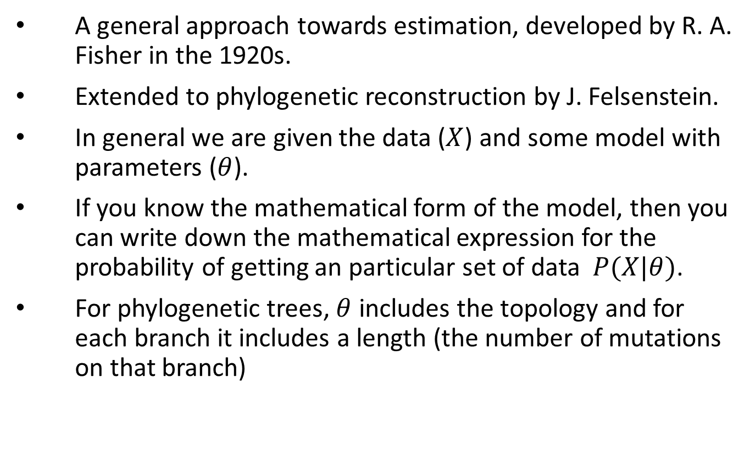
Maximum Likelihood
A general approach towards estimation, developed by R. A. Fisher in the 1920s.
Extended to phylogenetic reconstruction by J. Felsenstein.
In general we are given the data ($X$) and some model with parameters ($θ$).
If you know the mathematical form of the model, then you can write down the mathematical expression for the probability of getting an particular set of data $P(X|θ)$.
For phylogenetic trees, $θ$ includes the topology and for each branch it includes a length (the number of mutations on that branch)

Slide 56
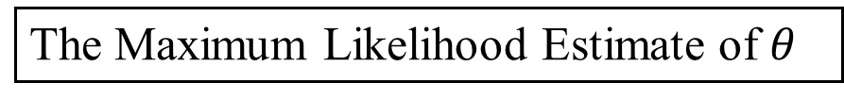


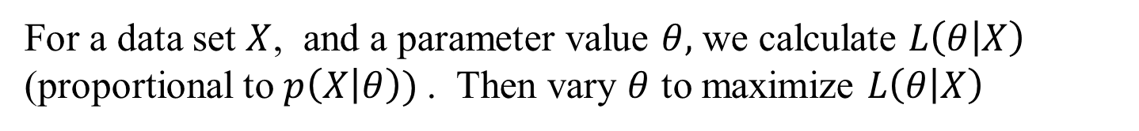
Maximum Likelihood diagram
For a data set $X$, and a parameter value $θ,$ we calculate $L\left(θ | X\right)$ (proportional to $p\left(X | θ\right))$. Then vary $θ$ to maximize $L\left(θ | X\right)$
The Maximum Likelihood
$$L\left(θ | X\right)$$
$θ$
The Maximum Likelihood Estimate of $θ$

Slide 57
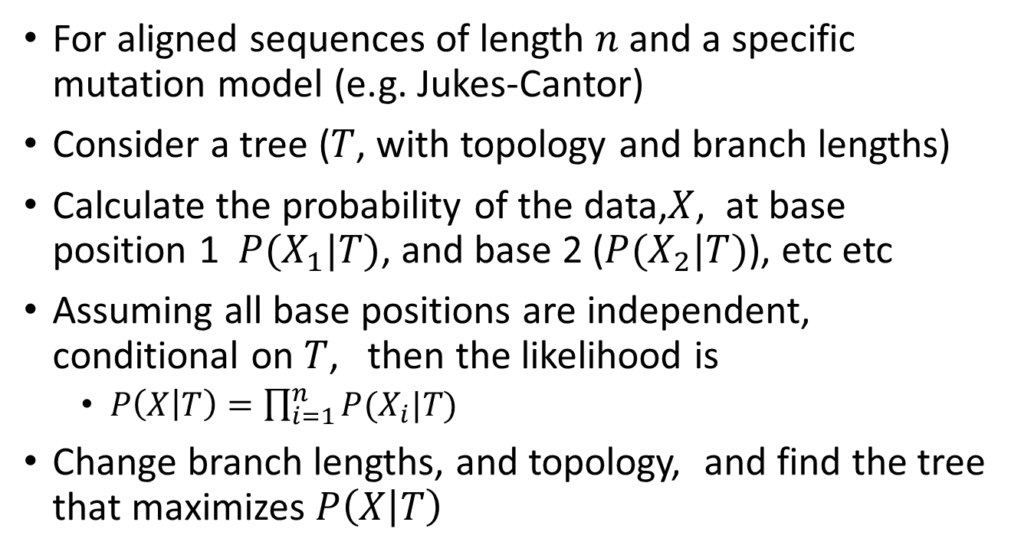
Phylogeny estimation by Maximum likelihood
For aligned sequences of length $n$ and a specific mutation model (e.g. Jukes-Cantor)
Consider a tree ($T$, with topology and branch lengths)
Calculate the probability of the data,$X$, at base position 1 $P(X_{1}|T)$, and base 2 ($P(X_{2}|T)$), etc etc
Assuming all base positions are independent, conditional on $T$, then the likelihood is
$P\left(X | T\right)=\prod_{i=1}^{n}{P(X_{i}|T)}$
Change branch lengths, and topology, and find the tree that maximizes $P\left(X | T\right)$

Slide 58
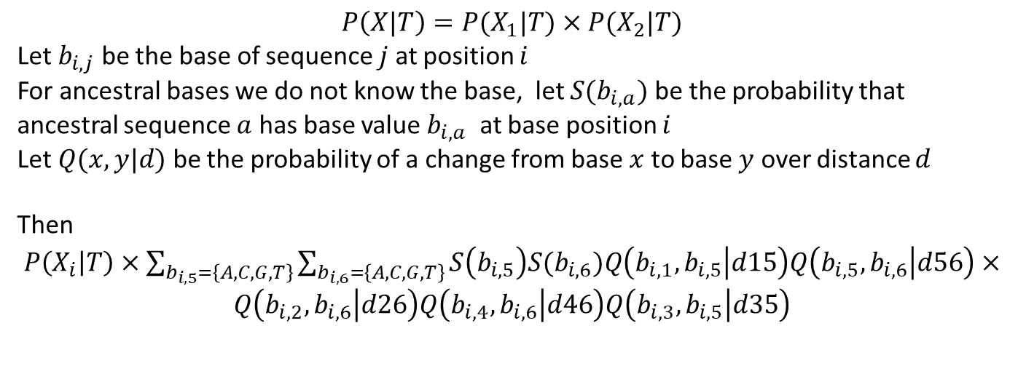
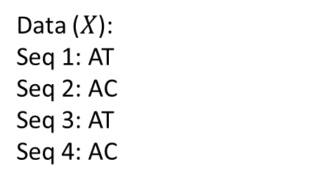

1
2
d26
Data ($X$):
Seq 1: AT
Seq 2: AC
Seq 3: AT
Seq 4: AC
d15
$$T=$$
5
6
d46
d56
d35
3
4
$$P\left(X|T\right)=P(X_{1}|T)×P(X_{2}|T)$$
Let $b_{i,j}$ be the base of sequence $j$ at position $i$
For ancestral bases we do not know the base, let $S(b_{i,a})$ be the probability that ancestral sequence $a$ has base value $b_{i,a}$ at base position $i$
Let $Q(x,y|d)$ be the probability of a change from base $x$ to base $y$ over distance $d$
Then
$P\left(X_{i} | T\right)×\sum_{b_{i,5}=\left\{A,C,G,T\right\}}{\sum_{b_{i,6}=\left\{A,C,G,T\right\}}{S\left(b_{i,5}\right)S(b_{i,6})Q\left(b_{i,1},b_{i,5} | d15\right)Q\left(b_{i,5},b_{i,6} | d56\right)×}}$
$$Q\left(b_{i,2},b_{i,6} | d26\right)Q\left(b_{i,4},b_{i,6} | d46\right)Q\left(b_{i,3},b_{i,5} | d35\right)$$
Note: we consider all base positions, whether or not they show variation
We must sum over all possible base values for each internal node sequence

